Slide 1
Artificial Intelligence in Games
05-09-007 Cengiz Karaboz
05-09-801 Sacit Bayraktar

Slide 2
Artificial Intelligence
Many applications for AI
Computer vision, natural language processing, speech recognition, search …
But games are some of the more interesting
Opponents that are challenging, or allies that are helpful
Unit that is credited with acting on own
Human-level intelligence too hard
But under narrow circumstances can do pretty well (ex: chess and Deep Blue)
For many games, often constrained (by game rules)
Artificial Intelligence (around in CS for some time)

Slide 3
AI for CS different than AI for Games
Must be smart, but purposely flawed
Loose in a fun, challenging way
No unintended weaknesses
No “golden path” to defeat
Must not look dumb
Must perform in real time (CPU)
Configurable by designers
Not hard coded by programmer

Slide 4
MinMax - Overview
Search tree
Squares represent decision states (ie- after a move)
Branches are decisions (ie- the move)
Start at root
Nodes at end are leaf nodes
Ex: Tic-Tac-Toe (symmetrical positions removed)
Unlike binary trees can have any number of children
Depends on the game situation
Levels usually called plies (a ply is one level)
Each ply is where "turn" switches to other player
Players called Min and Max (next)

Slide 5
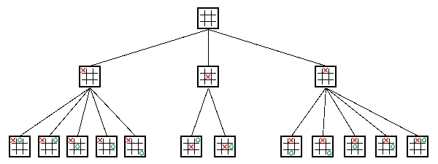
MinMax - Overview

Slide 6
MinMax - Algorithm
Named MinMax because of algorithm behind data structure
Assign points to the outcome of a game
Ex: Tic-Tac-Toe: X wins, value of 1. O wins, value -1.
Max (X) tries to maximize point value, while Min (O) tries to minimize point value
Assume both players play to best of their ability
Always make a move to minimize or maximize points
So, in choosing, Max will choose best move to get highest points, assuming Min will choose best move to get lowest points

Slide 7
MinMax – First Example
Max’s turn
Would like the “9” points (the maximum)
But if choose left branch, Min will choose move to get 3
→ left branch has a value of 3
If choose right, Min can choose any one of 5, 6 or 7 (will choose 5, the minimum)
→ right branch has a value of 5
Right branch is largest (the maximum) so choose that move
5
Max
3
4
5
Min
3
9
4
5
6
7
Max

Slide 8
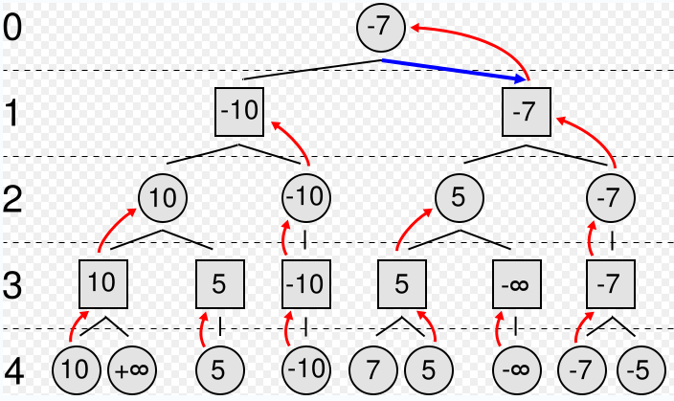
MinMax – Second Example
Max’s turn
Circles represent Max, Squares represent Min
Values inside represent the value the MinMax algorithm
Red arrows represent the chosen move
Numbers on left represent tree depth
Blue arrow is the chosen move
Max
Min
Max
Min

Slide 9
MinMax and Chess
With full tree, can determine best possible move
However, full tree impossible for some games! Ex: Chess
At a given time, chess has ~ 35 legal moves. Exponential growth:
35 at one ply, 35² = 1225 at two plies … 35⁶ = 2 billion and 35¹⁰ = 2 quadrillion
Games can last 40 moves (or more), so 35⁴⁰ … Stars in universe: ~ 2²⁸
For large games (Chess) can’t see end of the game. Must estimate winning or losing from top portion
Evaluate() function to guess end given board
A numeric value, much smaller than victory (ie- Checkmate for Max will be one million, for Min minus one million)
So, computer’s strength at chess comes from:
How deep can search
How well can evaluate a board position
(In some sense, like a human – a chess grand master can evaluate board better and can look further ahead)

Slide 10
MinMax – Pseudo Code (1 of 3)
int MinMax(int depth) {
// White is Max, Black is Min
if (turn == WHITE)
return Max(depth);
else
return Min(depth);
}
Then, call with:
value = MinMax(5); // search 5 plies

Slide 11
MinMax – Pseudo Code (2 of 3)
int Max(int depth) {
int best = -INFINITY; // first move is best
if (depth == 0)
return Evaluate();
GenerateLegalMoves();
while (MovesLeft()) {
MakeNextMove();
val = Min(depth – 1); // Min’s turn next
UnMakeMove();
if (val > best)
best = val;
}
return best;
}

Slide 12
MinMax – Pseudo Code (3 of 3)
int Min(int depth) {
int best = INFINITY; // ← different than MAX
if (depth == 0)
return Evaluate();
GenerateLegalMoves();
while (MovesLeft()) {
MakeNextMove();
val = Max(depth – 1); // Max’s turn next
UnMakeMove();
if (val < best) // ← different than MAX
best = val;
}
return best;
}

Slide 13
MinMax - Notes on Pseudo Code
Dual-recursive → call each other until bottom out (depth of zero is reached)
Try tracing with depth = 1
Essentially, try each move out, choose best
Need to modify to return best move. Implement:
When store “best”, also store “move”
Use global variable
Pass in move via reference
Use object/structure with “best” + “move”
Since Max() and Min() are basically opposites (zero-sum game), can make code shorter with simple flip
Called NegaMax

Slide 14
MinMax – NegaMax Pseudo Code
int NegaMax(int depth) {
int best = -INFINITY;
if (depth == 0)
return Evaluate();
GenerateLegalMoves();
while (MovesLeft()) {
MakeNextMove();
val = -1 * NegaMax(depth-1); // Note the -1
UnMakeMove();
if (val > best) // Still pick largest
best = val;
}
return best;
}
Note, the -1 causes Min to pick smallest, Max biggest
Ex: 4, 5, 6 → Max will pick ‘6’, while Min will pick ‘-4’ so ‘4’

Slide 15
MinMax – AlphaBeta Pruning
MinMax searches entire tree, even if in some cases the rest can be ignored
Example – Enemy lost bet. Owes you one thing from bag. You choose bag, but he chooses thing. Go through bags one item at a time.
First bag: Chicago White Sox tickets, sandwich, $20
He’ll choose sandwich
Second bag: Dead fish, …
He’ll choose fish. Doesn’t matter if rest is car, $500, Yankee’s tickets … Don’t need to look further. Can prune.
In general, stop evaluating move when find worse than previously examined move
→ Does not benefit the player to play that move, it need not be evaluated any further.
→ Save processing time without affecting final result

Slide 16
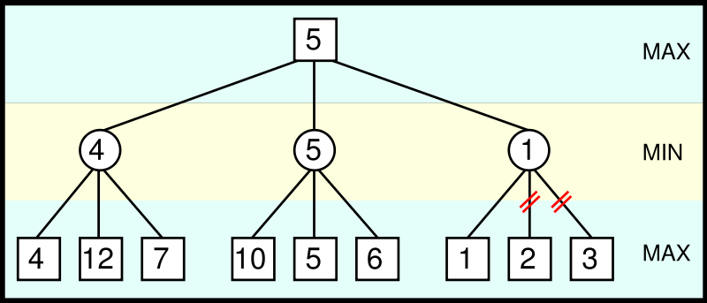
MinMax – AlphaBeta Pruning Example
From Max point of view, 1 is already lower than 4 or 5, so no need to evaluate 2 and 3 (bottom right) → Prune

Slide 17
MinMax – AlphaBeta Pruning Idea
Two scores passed around in search
Alpha – best score by some means
Anything less than this is no use (can be pruned) since we can already get alpha
Minimum score Max will get
Initially, negative infinity
Beta – worst-case scenario for opponent
Anything higher than this won’t be used by opponent
Maximum score Min will get
Initially, infinity
Recursion progresses, the "window" of Alpha-Beta becomes smaller
Beta < Alpha → current position not result of best play and can be pruned

Slide 18
MinMax – AlphaBeta Pseudo Code
int AlphaBeta(int depth, int alpha, int beta) {
if (depth <= 0)
return Evaluate();
GenerateLegalMoves();
while (MovesLeft()) {
MakeNextMove();
val = -1 * AlphaBeta(depth-1, -beta, -alpha);
UnMakeMove();
if (val >= beta)
return val;
if (val > alpha)
alpha = val;
}
return alpha;
}
Note, beta and alpha are reversed for subsequent calls
Note, the -1 for beta and alpha, too

Slide 19
MinMax – AlphaBeta Notes
Benefits heavily dependent upon order searched
If always start at worst, never prune
Ex: consider previous with node 1 first (worst)
If always start at best, branch at approximated sqrt(branch)
Ex: consider previous with 5 first (best)
For Chess:
If ~35 choices per ply, at best can improve from 35 to 6
→ Allows search twice as deep

Slide 20
MinMax – Notes
Chess has many forced tactical situations (ie- taken knight, better take other knight)
MinMax can leave hanging (at tree depth)
So, when done, check for captures only
Time to search can vary (depending upon Evaluate() and branches and pruning)
Instead, search 1 ply. Check time. If enough, search 2 plies. Repeat. Called iterative deepening
depth = 1;
while (1) {
Val = AlphaBeta(depth, -INF, INF)
If (timeOut()) break;
}
For enhancement, can pass in best set of moves (line) seen last iteration (principle variation)

Slide 21
MinMax – Evaluate()
Checkmate – worth more than rest combined
Typical, use weighted function:
c1*material + c2*mobility + c3*king safety + c4*center control + ...
Simplest is point value for material
pawn 1, knight 3, bishop 3, castle 5, queen 9
All other stuff worth 1.5 pawns (ie- can ignore most everything else)
What about a draw?
Can be good (ie- if opponent is strong)
Can be bad (ie- if opponent is weak)
Adjust with contempt factor
Makes a draw (0) slightly lower (play to win)

Slide 22
Game Agents
Most AI focuses around game agent
think of agent as NPC, enemy, ally or neutral
Loops through: sense-think-act cycle
Acting is event specific, so talk about sense and think first, then a bit on act
Sense
Think
Act

Slide 23
Game Agents – Sensing (1 of 2)
Gather current world state: barriers, opponents, objects, …
Needs limitations: avoid “cheating” by looking at game data
Typically, same constraints as player (vision, hearing range, etc.)
Vision
Can be quite complicated (CPU intensive) to test visibility (ie- if only part of an object visible)
Compute vector to each object
Check magnitude (ie- is it too far away?)
Check angle (dot product) (ie- within 120° viewing angle?)
Check if obscured. Most expensive, so do last.

Slide 24
Game Agents – Sensing (2 of 2)
Hearing
Ex- tip-toe past, enemy doesn’t hear, but if run past, enemy hears (stealth games, like Thief)
Implement as event-driven
When player performs action, notify agents within range
Rather than sound reflection (complicated) usually distance within bounded area
Can enhance with listen attributes by agent (if agent is “keen eared” or paying attention)
Communication
Model sensing data from other agents
Can be instant (ie- connected by radio)
Or via hearing (ie- shout)
Reaction times
Sensing may take some time (ie- don’t have agent react to alarm instantly, seems unrealistic)
Build in delay. Implement with simple timer.

Slide 25
Game Agents – Thinking (1 of 3)
Evaluate information and make decision
As simple or elaborate as required
Generally, two ways:
Pre-coded expert knowledge
Typically hand-crafted “if-then” rules + “randomness” to make unpredictable
Search algorithm for best (optimal) solution
Ex- MinMax

Slide 26
Game Agents – Thinking (2 of 3)
Expert Knowledge
Finite State Machines, decision trees, … (FSM most popular, details next)
Appealing since simple, natural, embodies common sense and knowledge of domain
Ex: See enemy weaker than you? → Attack. See enemy stronger? → Go get help
Trouble is, often does not scale
Complex situations have many factors
Add more rules, becomes brittle
Still, often quite adequate for many AI tasks
Many agents have quite narrow domain, so doesn’t matter

Slide 27
Game Agents – Thinking (3 of 3)
Search
Look ahead and see what move to do next
Ex: piece on game board (MinMax), pathfinding (A*)
Works well with known information (ie- can see obstacles, pieces on board)
Machine learning
Evaluate past actions, use for future action
Techniques show promise, but typically too slow

Slide 28
Game Agents – Acting (1 of 2)
Learning and Remembering
May not be important in many games where agent short-lived (ie- enemy drone)
But if alive for 30+ seconds, can be helpful
ie- player attacks from right, so shield right
Implementation - too avoid too much information, can have fade from memory (by time or by queue that becomes full)

Slide 29
Game Agents – Acting (2 of 2)
Making agents stupid
Many cases, easy to make agents dominate
Ex: FPS bot always makes head-shot
Dumb down by giving “human” conditions, longer reaction times, make unnecessarily vulnerable, have make mistakes
Agent cheating
Ideally, don’t have unfair advantage (such as more attributes or more knowledge)
But sometimes might “cheat” to make a challenge
Remember, that’s the goal, AI lose in challenging way
Best to let player know

Slide 30
Finite State Machines
Many different rules for agents
Ex: sensing, thinking and acting when fighting, running, exploring…
Can be difficult to keep rules consistent!
Try Finite State Machine
Probably most common game AI software pattern
Natural correspondence between states and behaviors
Easy: to diagram, program, debug
General to any problem
See AI Depot - FSM
For each situation, choose appropriate state
Number of rules for each state is small

Slide 31
Finite State Machines
Abstract model of computation
Formally:
Set of states
A starting state
An input vocabulary
A transition function that maps inputs and the current state to a next state

Slide 32
Finite State Machines – Example (1 of 2)
Game where raid Egyptian Tomb
Mummies! Behavior
Spend all of eternity wandering in tomb
When player is close, search
When see player, chase
Make separate states
Define behavior in each state
Wander – move slowly, randomly
Search – move faster, in lines
Chasing – direct to player
Define transitions
Close is 100 meters (smell/sense)
Visible is line of sight
Wandering
Close by
Far away
Searching
Visible
Hidden
Chasing

Slide 33
Finite State Machines – Example (2 of 2)
Can be extended easily
Ex: Add magical scarab (amulet)
When player gets scarab, Mummy is afraid. Runs.
Behavior
Move away from player fast
Transition
When player gets scarab
When timer expires
Can have sub-states
Same transitions, but different actions
ie- range attack versus melee attack
Wandering
Timer
Expires
Scarab
Close by
Far away
Searching
Afraid
Scarab
Visible
Hidden
Chasing
Scarab

Slide 34
Finite-State Machine: Approaches
Three approaches
Hardcoded (switch statement)
Scripted
Hybrid Approach

Slide 35
Hardcoded FSM
void Step(int *state) { // call by reference since state can change
switch(state) {
case 0: // Wander
Wander();
if( SeeEnemy() ) { *state = 1; }
break;
case 1: // Attack
Attack();
if( LowOnHealth() ) { *state = 2; }
if( NoEnemy() ) { *state = 0; }
break;
case 2: // Flee
Flee();
if( NoEnemy() ) { *state = 0; }
break;
}
}

Slide 36
Problems with switch FSM
1. Code is ad hoc
Language doesn’t enforce structure
2. Transitions result from polling (checking each time)
Inefficient – event-driven sometimes better
ie- when damage, call “pain” event for monster and it may change states
3. Can’t determine 1st time state is entered
4. Can’t be edited or specified by game designers or players

Slide 37
Alternative Implementation
Make objects
Transitions are events (passed by objects creating events)
Ex: player runs. All objects within hearing range get “run sound” event
Each object can have step event
Gets mapped to right action in state by call back

Slide 38
Scripted with Alternative Language
AgentFSM {
State( STATE_Wander )
OnUpdate
Execute( Wander )
if( SeeEnemy ) SetState( STATE_Attack )
OnEvent( AttackedByEnemy )
SetState( Attack )
State( STATE_Attack )
OnEnter
Execute( PrepareWeapon )
OnUpdate
Execute( Attack )
if( LowOnHealth ) SetState( STATE_Flee )
if( NoEnemy ) SetState( STATE_Wander )
OnExit
Execute( StoreWeapon )
State( STATE_Flee )
OnUpdate
Execute( Flee )
if( NoEnemy ) SetState( STATE_Wander )
}

Slide 39
Scripting Advantages
1. Structure enforced
2. Events can be handed as well as polling
3. OnEnter and OnExit concept exists
(If objects, when created or destroyed)
4. Can be authored by game designers
Easier learning curve than straight C/C++

Slide 40
Scripting Disadvantages
Not trivial to implement
Several months of development of language
Custom compiler
With good compile-time error feedback
Bytecode interpreter
With good debugging hooks and support
Scripting languages often disliked by users
Can never approach polish and robustness of commercial compilers/debuggers

Slide 41
Hybrid Approach
Use a class and C-style macros to approximate a scripting language
Allows FSM to be written completely in C++ leveraging existing compiler/debugger
Capture important features/extensions
OnEnter, OnExit
Timers
Handle events
Consistent regulated structure
Ability to log history
Modular, flexible, stack-based
Multiple FSMs, Concurrent FSMs
Can’t be edited by designers or players

Slide 42
Finite-State Machine: Extensions
Many possible extensions to basic FSM
Event driven: OnEnter, OnExit
Timers: transition after certain time
Global state with sub-states (same transitions, different actions)
Stack-Based (states or entire FSMs)
Easy to revert to previous states
Good for resuming earlier action
Multiple concurrent FSMs
Lower layers for, say, obstacle avoidance – high priority
Higher layers for, say, strategy

Slide 43
Common Game AI Techniques (1 of 4)
Whirlwind tour of common techniques
For each, provide idea and example (where appropriate)
Subset and grouped based on text
Movement
Flocking
Move groups of creatures in natural manner
Each creature follows three simple rules
Separation – steer to avoid crowding flock mates
Alignment – steer to average flock heading
Cohesion – steer to average position
Example – use for background creatures such as birds or fish. Modification can use for swarming enemy
Formations
Like flocking, but units keep position relative to others
Example – military formation (archers in the back)

Slide 44
Common Game AI Techniques (2 of 4)
Movement (continued)
A* pathfinding
Cheapest path through environment
Directed search exploit knowledge about destination to intelligently guide search
Fastest, widely used
Can provide information (ie- virtual breadcrumbs) so can follow without recompute
See: http://www.antimodal.com/astar/
Obstacle avoidance
A* good for static terrain, but dynamic such as other players, choke points, etc.
Example – same path for 4 units, but can predict collisions so furthest back slow down, avoid narrow bridget, etc.

Slide 45
Common Game AI Techniques (3 of 4)
Behavior organization
Emergent behavior
Create simple rules result in complex interactions
Example: game of life, flocking
Command hierarchy
Deal with AI decisions at different levels
Modeled after military hierarchy (ie- General does strategy to Foot Soldier does fighting)
Example: Real-time or turn based strategy games -- overall strategy, squad tactics, individual fighters
Manager task assignment
When individual units act individually, can perform poorly
Instead, have manager make tasks, prioritize, assign to units
Example: baseball – 1st priority to field ball, 2nd cover first base, 3rd to backup fielder, 4th cover second base. All players try, then disaster. Manager determines best person for each. If hit towards 1st and 2nd, first baseman field ball, pitcher cover first base, second basemen cover first

Slide 46
Common Game AI Techniques (4 of 4)
Influence map
2d representation of power in game
Break into cells, where units in each cell are summed up
Units have influence on neighbor cells (typically, decrease with range)
Insight into location and influence of forces
Example – can be used to plan attacks to see where enemy is weak or to fortify defenses. SimCity used to show fire coverage, etc.
Level of Detail AI
In graphics, polygonal detail less if object far away
Same idea in AI – computation less if won’t be seen
Example – vary update frequency of NPC based on position from player

Slide 47
Promising AI Techniques (1 of 3)
Bayesian network
A probabilistic graphical model with variables and probable influences
Example - calculate probability of patient having a specific disease given symptoms
Example – AI can infer if player has warplanes, etc. based on what it sees in production so far
Can be good to give “human-like” intelligence without cheating or being too dumb
Decision tree learning
Series of inputs (usually game state) mapped to output (usually thing want to predict)
Example – health and ammo → predict bot survival
Modify probabilities based on past behavior
Example – Black and White could stroke or slap creature. Learned what was good and bad.

Slide 48
Promising AI Techniques (2 of 3)
Filtered randomness
Want randomness to provide unpredictability to AI
But even random can look odd (ie- if 4 heads in a row, player think something wrong. And, if flip coin 100 times, will be streak of 8)
Example – spawn at same point 5 times in a row, then bad
Compare random result to past history and avoid
Fuzzy logic
Traditional set, object belongs or not.
In fuzzy, can have relative membership (ie- hungry, not hungry. Or “in-kitchen” or “in-hall” but what if on edge?)
Cannot be resolved by coin-flip
Can be used in games – ie- assess relative threat

Slide 49
Promising AI Techniques (3 of 3)
Genetic algorithms
Search and optimize based on evolutionary principles
Good when “right” answer not well-understood
Example – may not know best combination of AI settings. Use GA to try out
Often expensive, so do offline
N-Gram statistical prediction
Predict next value in sequence (ie- 1818180181 … next will probably be 8)
Search backward n values (usually 2 or 3)
Example
Street fighting (punch, kick, low punch…)
Player does low kick and then low punch. What is next?
Uppercut 10 times (50%), low punch (7 times, 35%), sideswipe (3 times, 15%)
Can predict uppercut or, proportionally pick next (ie- roll dice)

Slide 50
Summary
AI for games different than other fields
Intelligent opponents, allies and neutral’s but fun (lose in challenging way)
Still, can draw upon broader AI techniques
Agents – sense, think, act
Advanced agents might learn
Finite state machines allow complex expertise to be expressed, yet easy to understand and debug
Dozens of other techniques to choose from

